Slide 1



Let’s learn!
In the Name of God
Chapter 2: New Words

Slide 2
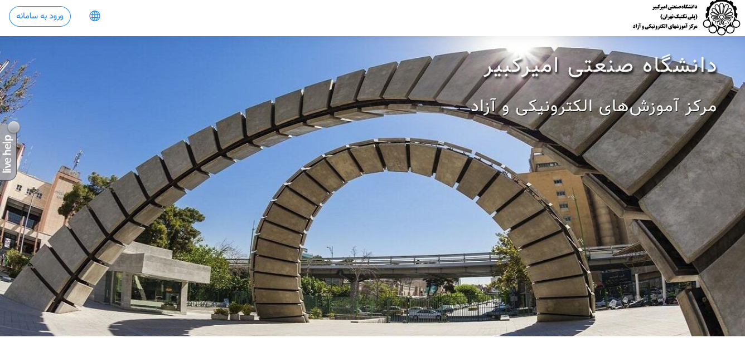
Adopter [N] /əˈdɑːptər/
Chooser
Amirkabir University students are the willing adopters of online courses.

Slide 3
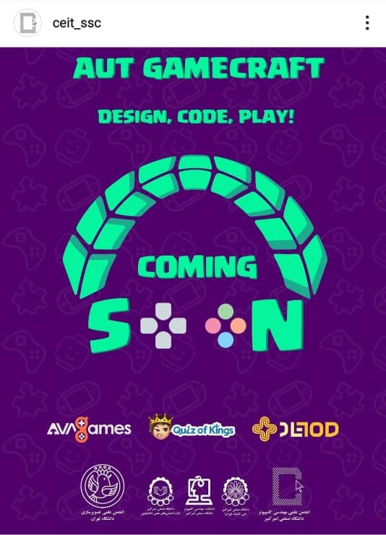
Assign [V] /əˈsaɪn/
to give someone a particular job or make them responsible for a particular person/thing
Shahriar, Amir, and Ali Reza were assigned the task of moderating different teams in GameCraft competition.

Slide 4

Appliance [N] /əˈplaɪəns/
A piece of electrical equipment such as a cooker or washing machine
Parsa, Kian, and Meraj are going to attend the upcoming international smart home exhibition to learn about the latest trends in designing smart appliances.

Slide 5
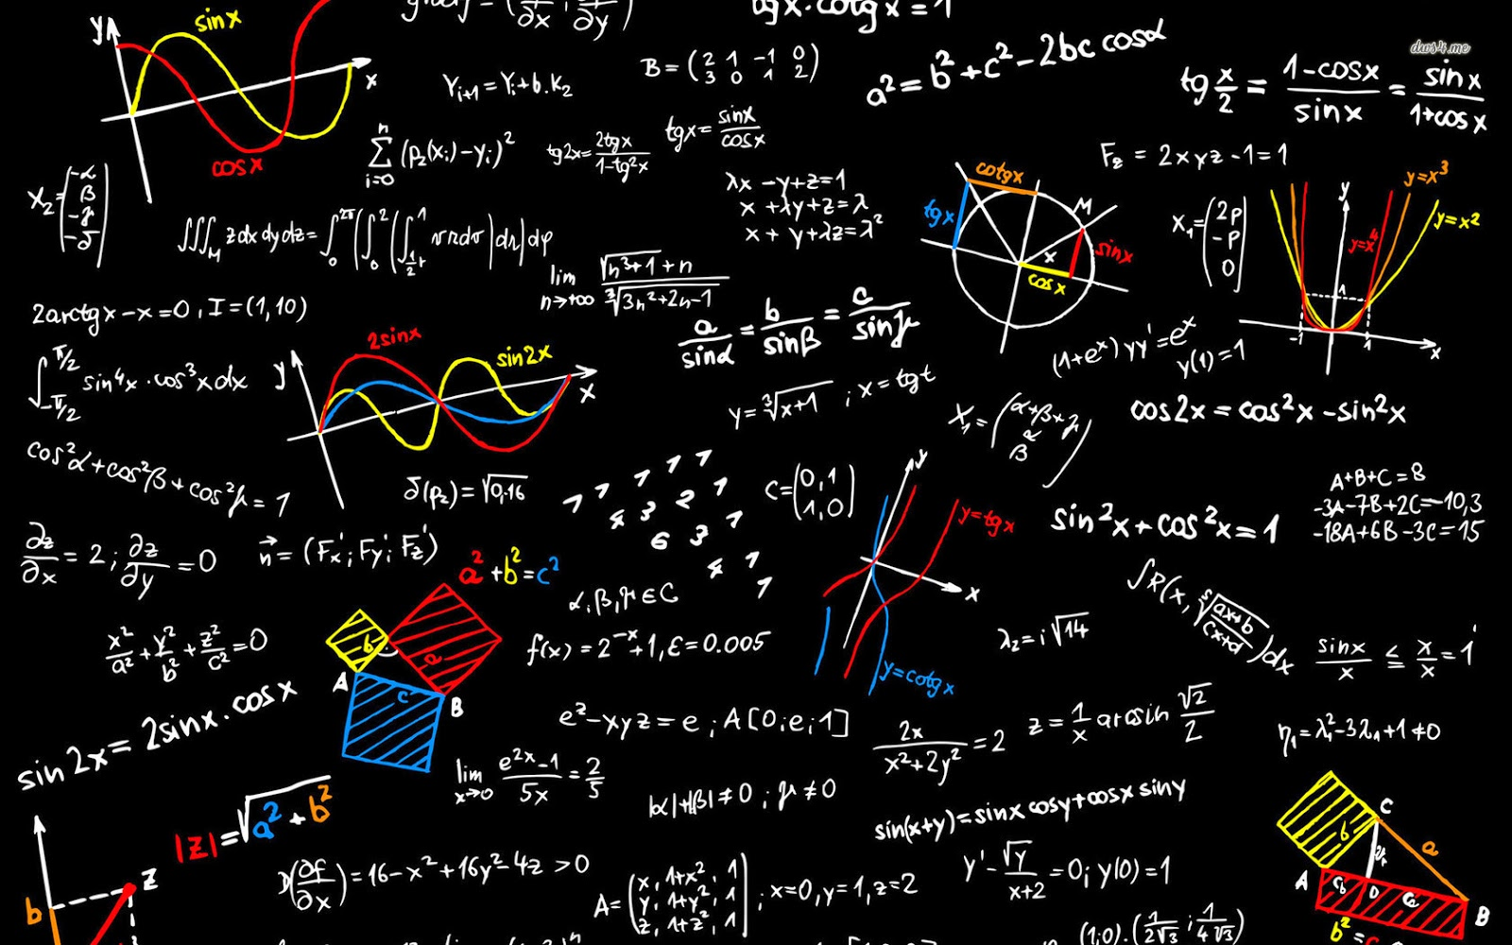
Capable [Adj] /ˈkeɪpəbəl/
Able to do things well
Hanieh, Sajedeh, Amir Reza, Mohammad, and Sina are known as capable students in Mathematics and Physics.

Slide 6
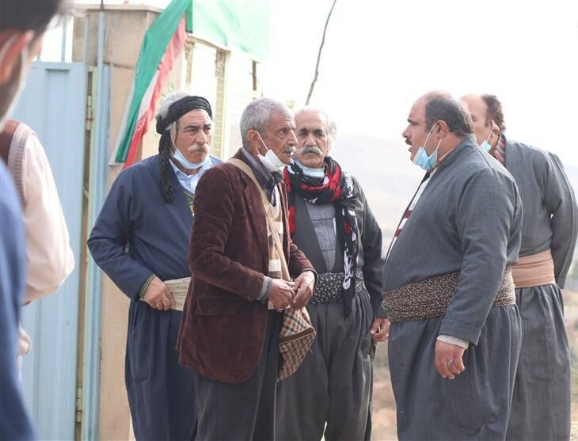
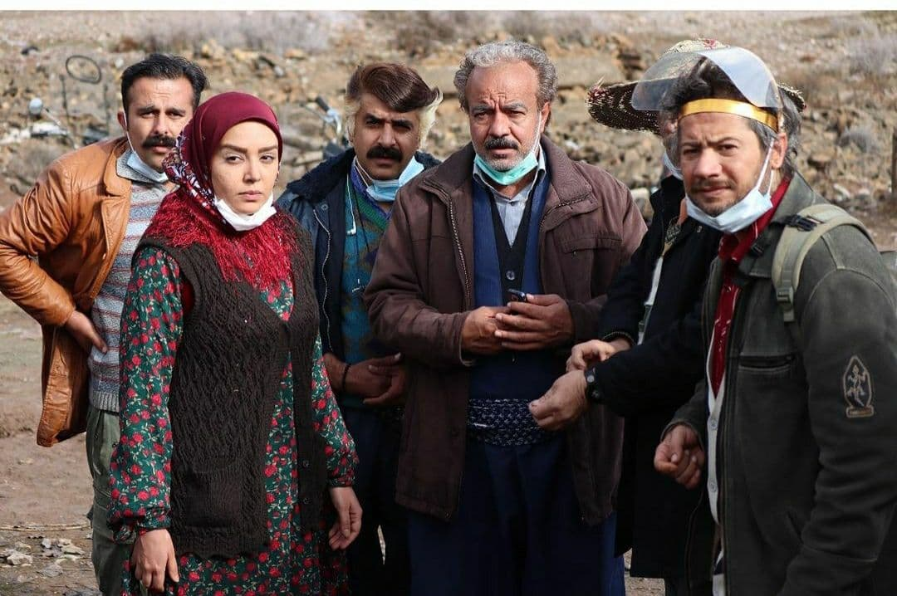
Cattle[N] /ˈkætl/
Cows and bulls kept on a farm for their meat or milk
Salman has a herd of cattle.
Crop [N] / krɑːp/
A plant such as wheat, rice, and fruit that is grown by farmers and used as food
Nourodin grows medicinal crops on his farm.

Slide 7

Challenge [N] /ˈtʃæləndʒ/
Competition, something that needs great efforts
Ashkan, Mohammad Mahdi, Sahand, and Hosein are tirelessly working in their teams to beat their rivals in AI Challenge.
Sajad, Arian, Sina, and Mohammad Hosein are establishing their start-up company to meet the challenges of smart cities.

Slide 8
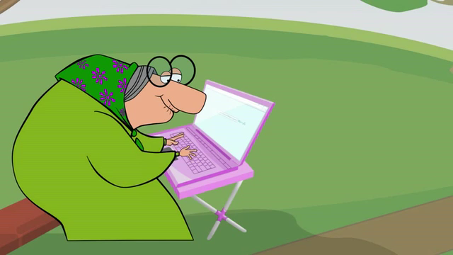

Cybercrime [N] /ˈsaɪbəkraɪm /
Criminal activity that involves the use of computers or the Internet
Strict measures must be taken to protect grandparents against cybercrimes.
Mostafa and Amir Ali think that most businesses are not taking adequate precaution to overcome cybercrime.

Slide 9
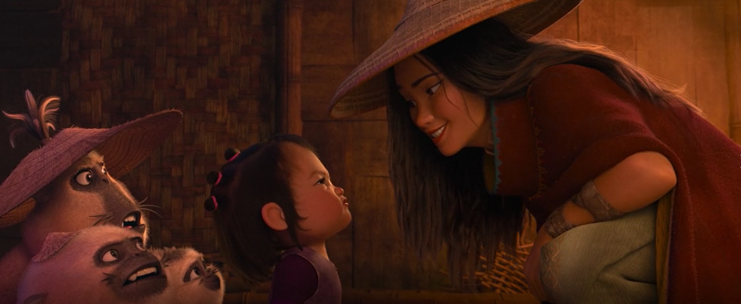

Downside [N] /ˈdaʊnsʌɪd/
disadvantage
Faezeh, Hadis, Negar, and Maedeh watched different movies during the holidays. They believe that one of the downsides of “Raya and the last dragon” is its simple plot.

Slide 10

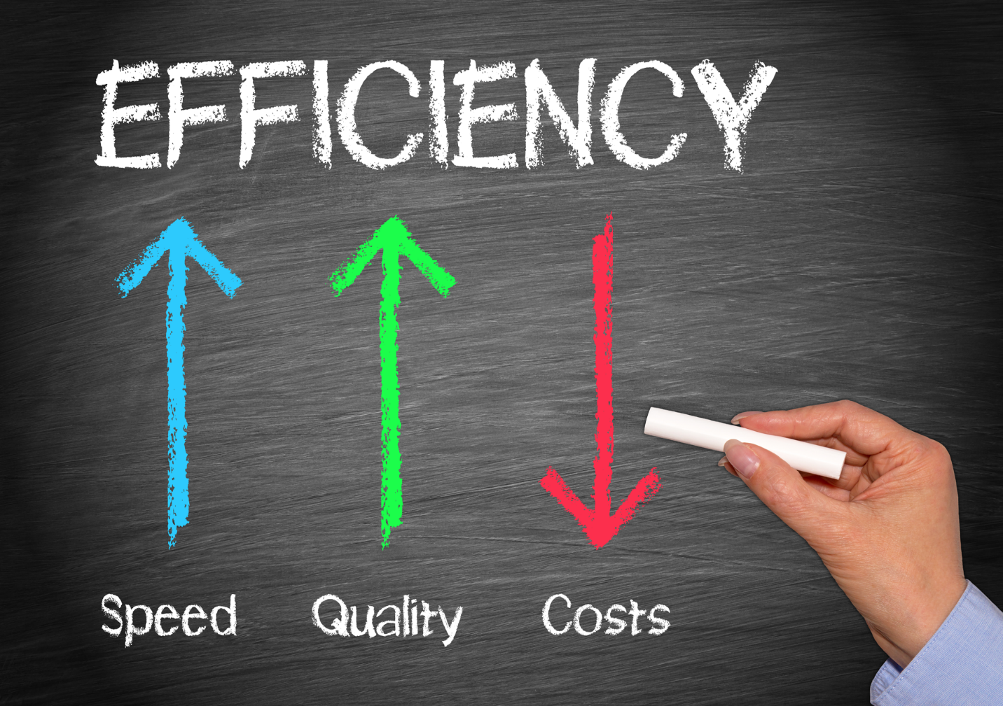
Efficiency [N] /ɪˈfɪʃənsi/
The quality of doing something well and effectively, without wasting time, money, or energy
How could we increase the efficiency of e-learning industry?
Emad is going to work as the industrial engineer in a well-known company which is taking steps to improve efficiency and reduce costs.

Slide 11
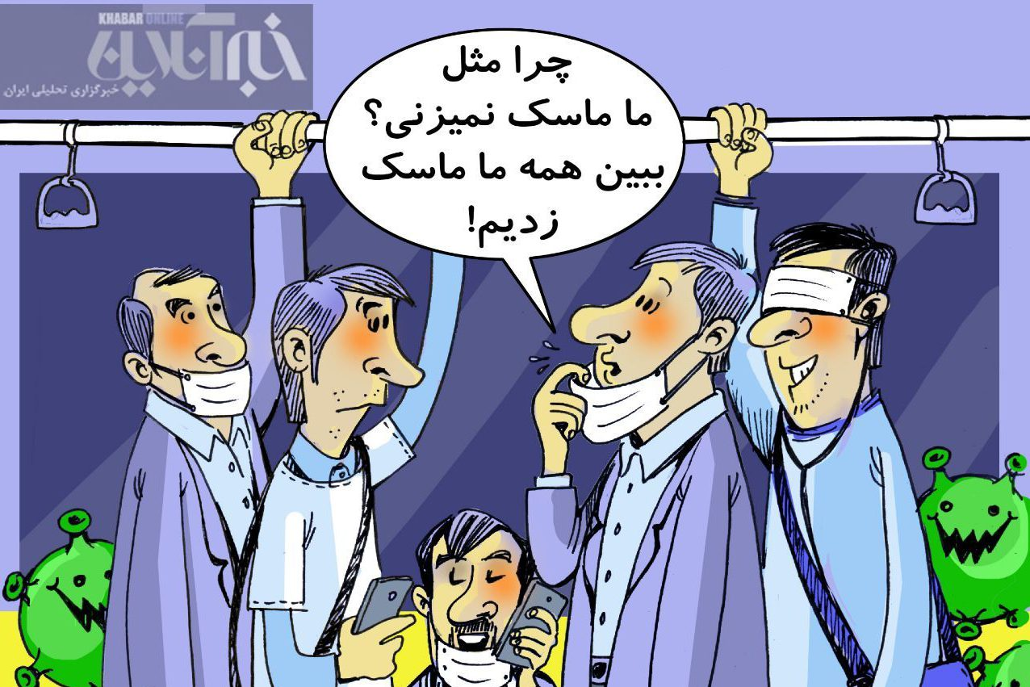

Ensure [V] /ɪnˈʃʊr/
to make sure: guarantee
Aida, Paria, Fatemeh, and Helia ensure that they put on mask to safeguard themselves against Covid-19.

Slide 12

Groundbreaking [Adj] /ˈɡraʊndˌbreɪkɪŋ/
Innovative, pioneering
Groundbreaking research
Did you find Christopher Nolan’s latest movie groundbreaking?

Slide 13

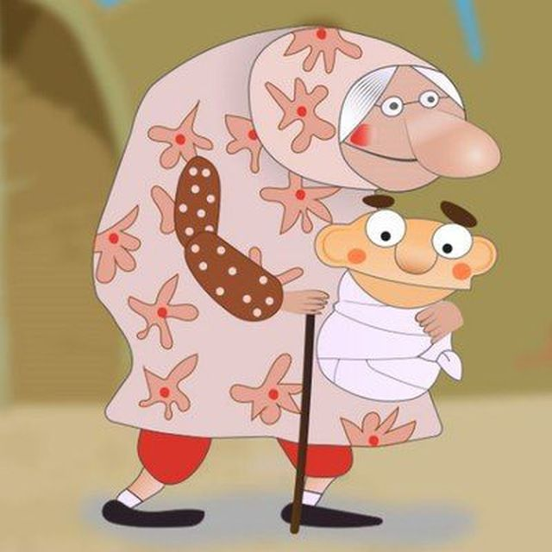
Implant [N] /ˈɪmplænt/
something artificial that is put into someone’s body in a medical operation
Why do some units use expensive implants and risk closure when the money runs out?
Infancy [N] /ˈɪnfənsi/
The time when something is just starting to be developed
Eskandar is in his infancy.
Machine learning is still in its infancy.

Slide 14

Innovation [N] /ˌɪnəˈveɪʃən/
A new idea
Ehsan and Mitra believe that innovation could be the solution to any problem.
We must encourage innovation if the company is to remain competitive.

Slide 15
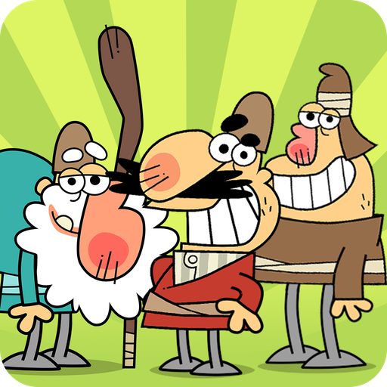

Toner [N] /ˈtoʊnər/
a type of ink that is used in machines that print
Reza attempted to print a book chapter, but the printer was out of toner and he had to read it online.
Relatively [Adv] /ˈrelətɪvli/
Fairly
E-commerce is a relatively recent phenomenon.
Tina, Sarvenaz, and Mahia believe that it is not relatively simple to make animations.

Slide 16
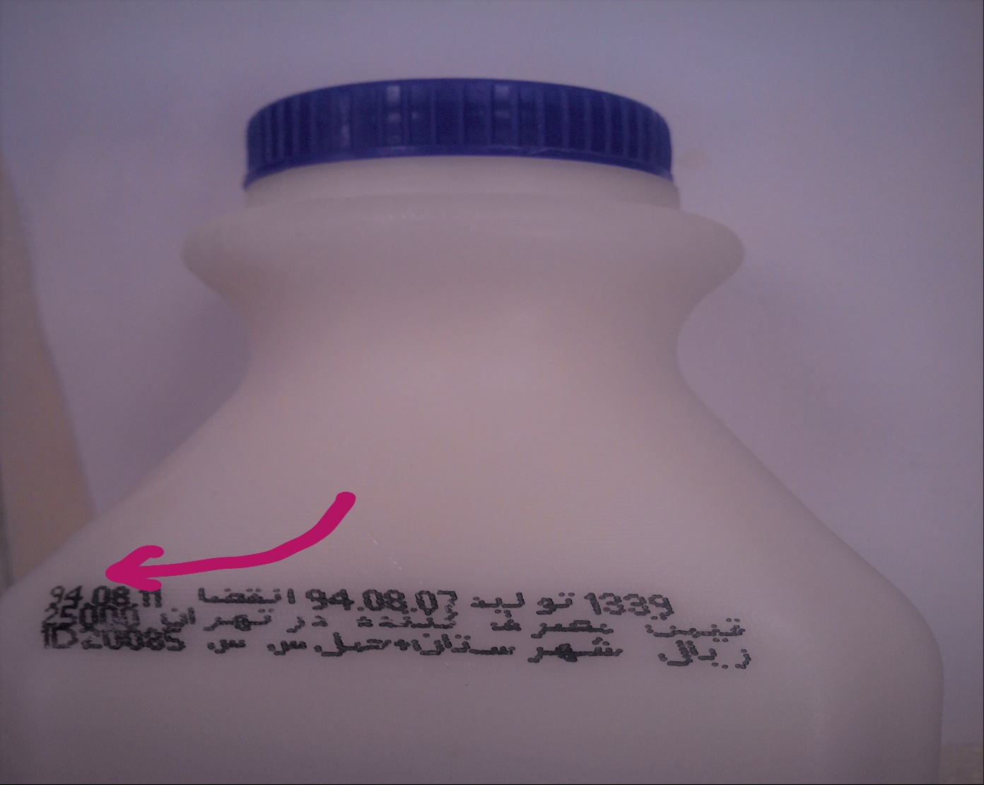
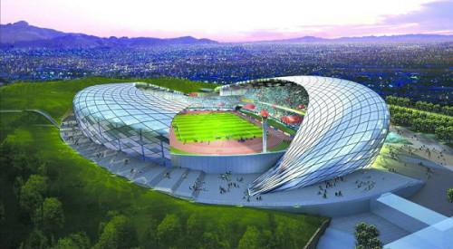
Use-by date:
The last date that a product, especially food, should be used
Aidin forgot to check the use-by date on the packet.
Unveil [V] /ʌnˈveɪl/
show or tell people about a new product/plan for the first time
The club has unveiled plans to build a new stadium.

Slide 17

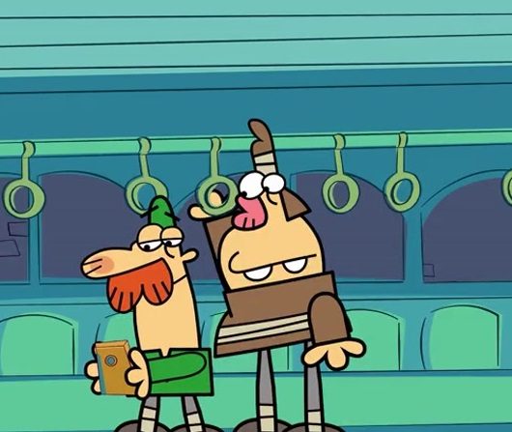
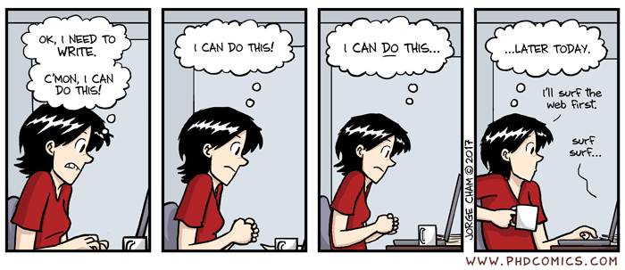
Manufacturing
No Privacy!
No Productivity!

Slide 18
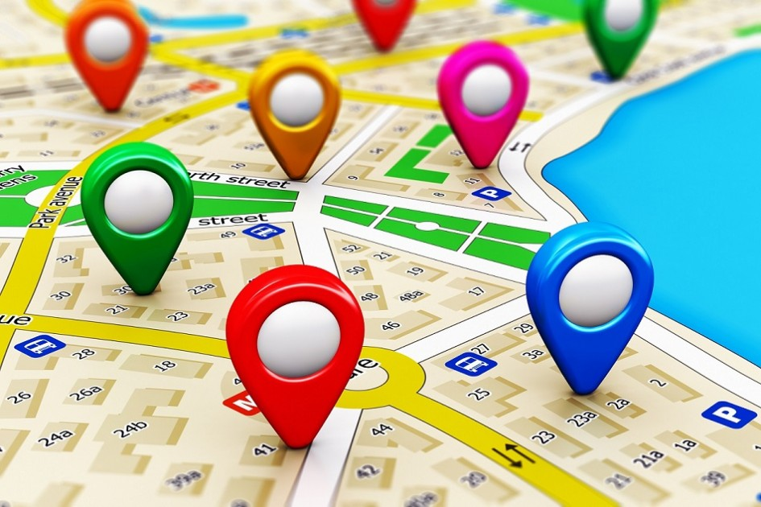


Monitor
Tracking
Target

Slide 19
